Slide 1

STATS 432 Computational Statistics
Chapter 8 – Markov Chains

Slide 2

8.1 – Discrete State Space Markov Chains

Slide 3
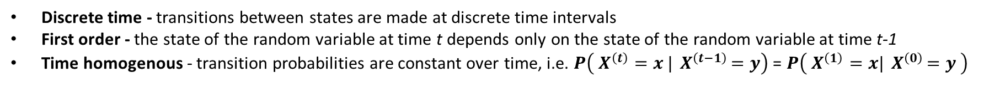
8.1a – Definition of a Markov Chain:
8.1 – Discrete State Space MCs
Suppose we have a sequence of random variables ${\left\{X^{\left(t\right)}\right\}}_{t=0}^{∞}$ indexed by discrete time intervals t = 0, 1, … , ∞ that take discrete values in the (finite or countable) state space S.
If the sequence has the Markov property…
$$P\left( X^{\left(t\right)}=x_{t} |{ X}^{\left(t−1\right)}=x_{t−1} , { X}^{\left(t−2\right)}=x_{t−2} , …,{ X}^{\left(0\right)}=x_{0 }\right) =P\left( X^{\left(t\right)}=x_{t} |{ X}^{\left(t−1\right)}=x_{t−1} \right)$$
i.e. the state of the random variable at time t depends only on the state of the random variable at time t-1.
… then this sequence is known as a Markov Chain (MC).
In the context of Stat 432 we will consider only Markov Chains that are:
Discrete time - transitions between states are made at discrete time intervals
First order - the state of the random variable at time t depends only on the state of the random variable at time t-1
Time homogenous - transition probabilities are constant over time, i.e. $P\left( X^{\left(t\right)}=x |{ X}^{\left(t−1\right)}=y\right)$ = $P\left( X^{\left(1\right)}=x|{ X}^{\left(0\right)}=y \right)$
3

Slide 4
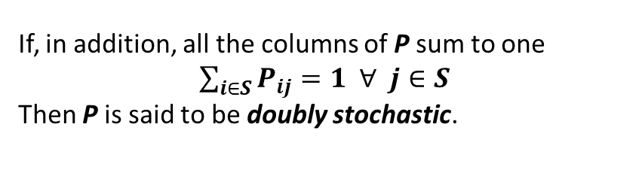

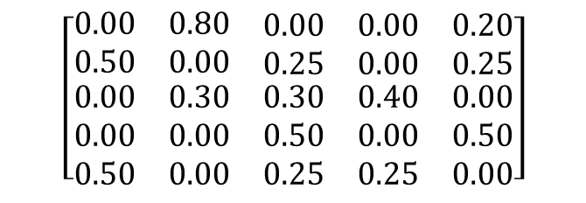
8.1b – Transition Probabilities:
8.1 – Discrete State Space MCs
A discrete state space Markov Chain ${\left\{X^{\left(t\right)}\right\}}_{t=0}^{∞}$ can be defined either by:
A transition matrix P where $P_{ij}$ describes the probability of the chain going from state i to state j.
A weighted directed graph G.
0.5
1
0.8
To
1
2
3
4
5
0.2
0.5
1
5
2
$$\left[\begin{matrix}0.00 & 0.80 & \begin{matrix}0.00 & 0.00 & 0.20\end{matrix} \\ 0.50 & 0.00 & \begin{matrix}0.25 & 0.00 & 0.25\end{matrix} \\ \begin{matrix}0.00 \\ 0.00 \\ 0.50\end{matrix} & \begin{matrix}0.30 \\ 0.00 \\ 0.00\end{matrix} & \begin{matrix}\begin{matrix}0.30 \\ 0.50 \\ 0.25\end{matrix} & \begin{matrix}0.40 \\ 0.00 \\ 0.25\end{matrix} & \begin{matrix}0.00 \\ 0.50 \\ 0.00\end{matrix}\end{matrix}\end{matrix}\right]$$
2
0.25
3
From
0.25
0.3
4
0.25
5
0.5
0.25
0.5
We note that transition matrices are always stochastic, i.e.
$\sum_{j∈S}{P_{ij}}=1 ∀ i∈S$
such that the rows of P always sum to one.
4
3
0.4
0.3
If, in addition, all the columns of P sum to one
$\sum_{i∈S}{P_{ij}}=1 ∀ j∈S$
Then P is said to be doubly stochastic.
Note: All transition matrices are stochastic. There is no reason why they should be doubly stochastic.
4

Slide 5
8.1b – Transition Probabilities:
8.1 – Discrete State Space MCs
# 1.1a - Defining state space and transition matrix.
library(markovchain)
statenames <- c("1", "2", "3", "4" , "5")
P <- matrix(c(0.00, 0.80, 0.00, 0.00, 0.20,
0.50, 0.00, 0.25, 0.00, 0.25,
0.00, 0.30, 0.30, 0.40, 0.00,
0.00, 0.00, 0.50, 0.00, 0.50,
0.50, 0.00, 0.25, 0.25, 0.00), nrow=5, byrow=TRUE,
dimnames = list(statenames, statenames))
0.5
1
0.8
0.2
0.5
5
2
0.25
0.25
0.3
0.25
0.25
# 1.1b - Specifying that the transition matrix defines a Markov chain
mc <- new("markovchain", transitionMatrix=P)
0.5
0.5
4
3
# 1.1c - Constructing a graph of the Markov chain
mc@transitionMatrix <- P
plot(mc)
0.4
0.3
# 1.1d - Conducting a random walk on the Markov Chain stating a state 1 markovchainSequence(n=10, markovchain=mc, t0="1",
include=TRUE)
[1] "1" "2" "1" "5" "1" "2" "3" "3" "4" "5" "3"
5
Associated Code = 8.1 – Random Walk on a Markov Chain

Slide 6

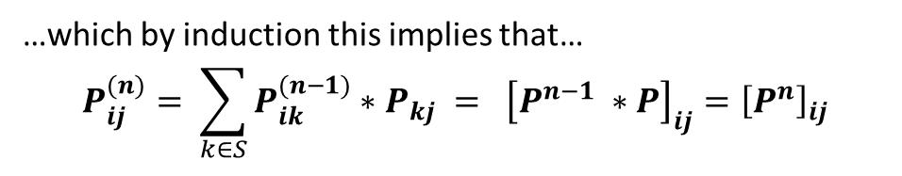
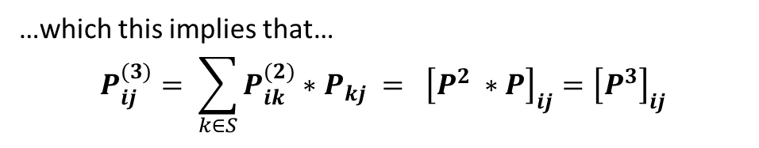
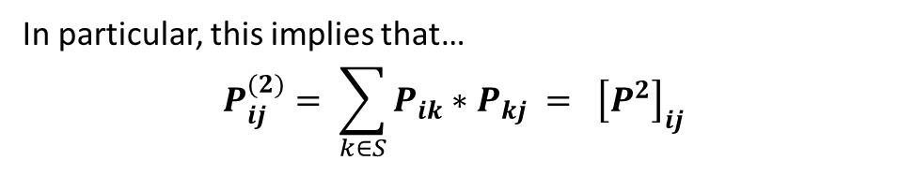

8.1c – n-Step Transition Probabilities:
8.1 – Discrete State Space MCs
The probability that the chain goes from state i to state j in n steps is denoted by $P_{ij}^{(n)}$.
j
The Kolmogorov-Chapman equations state that
$$P_{ij}^{(m+n)}= \sum_{k∈S}{P_{ik}^{(m)}∗P_{kj}^{(n)}}$$
i
In particular, this implies that…
$$P_{ij}^{(2)}= \sum_{k∈S}{P_{ik}∗P_{kj}} = {\left[P^{2}\right]}_{ij}$$
m
m+n
…which this implies that…
$$P_{ij}^{(3)}= \sum_{k∈S}{P_{ik}^{(2)}∗P_{kj}} = {\left[P^{2} ∗P\right]}_{ij}={\left[P^{3}\right]}_{ij}$$
If you want to find the probability of the chain going state i to state j in n steps…
Take the matrix P raise it to the power of n and read off the (ij)^{th} element
…which by induction this implies that…
$$P_{ij}^{(n)}= \sum_{k∈S}{P_{ik}^{(n−1)}∗P_{kj}} = {\left[P^{n−1} ∗P\right]}_{ij}={\left[P^{n}\right]}_{ij}$$
6

Slide 7
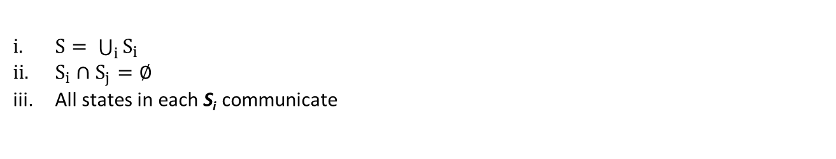
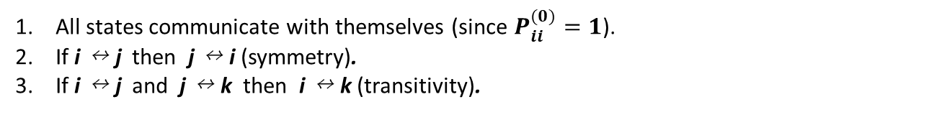
8.1d – Communication Classes:
8.1 – Discrete State Space MCs
We say that state j is accessible from state i (denoted i → j) if $∃ n≥1$ such that $P_{ij}^{(n)}>0$
i.e. it is possible to reach state j from state i.
We say that state i and j communicate (denoted i ↔ j) if $∃ n_{1}, n_{2}≥1$ such that $P_{ij}^{(n_{1})}>0, P_{ji}^{(n_{2})}>0$
i.e. it is possible to reach state i from state j and vice versa
Communication is an equivalence relation, i.e.
All states communicate with themselves (since $P_{ii}^{(0)}=1$).
If i ↔ j then j ↔ i (symmetry).
If i ↔ j and j ↔ k then i ↔ k (transitivity).
Theorem 1:
Let ${\left\{X^{\left(t\right)}\right\}}_{t=0}^{∞}$ be a discrete state space Markov chain with State Space S.
S can be uniquely decomposed into a sequence of disjoint subsets S_{i} such that
$S= \bigcup_{i}{S_{i}}$
$S_{i}∩S_{j}=∅$
All states in each S_{i} communicate
=> You can always decompose a Markov chain into a disjoint sequence of communication classes
7

Slide 8


8.1d – Communication Classes:
8.1 – Discrete State Space MCs
A Markov chain in which all states communicate (equivalently for which there is only one communication class) is called an irreducible Markov Chain.
A Markov chain in which there is more than one communication class is called a reducible Markov Chain i.e. there exists $S_{i}⊊S$ such that $P_{ij}=0 ∀ i∈S_{i} j∉S_{i}$
Irreducible
Reducible
0.5
1
0.8
0.2
1
3
4
5
0.5
5
2
0.25
0.25
0.3
8
6
0.25
0.25
2
0.5
0.5
7
4
3
0.4
0.3
$$S=\{1, 2, 3, 4, 5\}$$
$$S=\left\{1,2\right\}∪\left\{3, 4\right\}∪\{5\}∪\{6, 7, 8\}$$
8

Slide 9
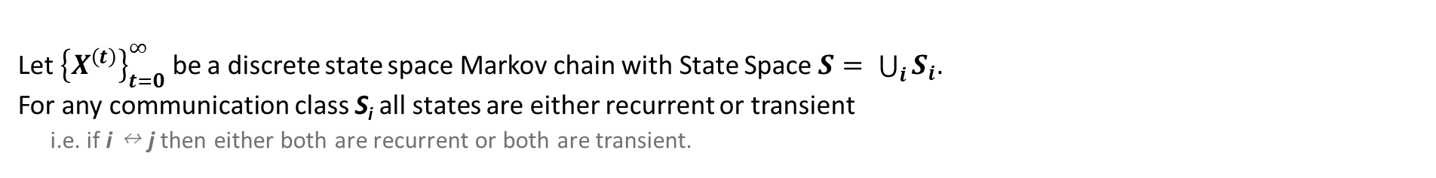
8.1e – Recurrence & Transience:
8.1 – Discrete State Space MCs
Define $f_{ii}=P\left(X^{(n)}=i for some n≥1 | X^{\left(0\right)}=i \right)$
Hence $f_{ii}$ is the probability that the chain will return to state i at some point in the future given that it started there.
If $f_{ii}=1$ then the chain is certain to return to state i at some point in the future.
State i is known as a recurrent state.
By definition of the Markov property, the chain will visit a recurrent state an infinite number of times.
If $f_{ii}<1$ then the chain is not certain to return to state i at some point in the future.
State i is known as a transient state.
The chain will visit a transient state only a finite number of times.
Theorem 2:
Let ${\left\{X^{\left(t\right)}\right\}}_{t=0}^{∞}$ be a discrete state space Markov chain with State Space $S= \bigcup_{i}{S_{i}}$.
For any communication class S_{i} all states are either recurrent or transient i.e. if i ↔ j then either both are recurrent or both are transient.
“If two states communicate, they share the same nature”
If all states in a Markov chain are recurrent, then we say that the chain is recurrent.
9

Slide 10

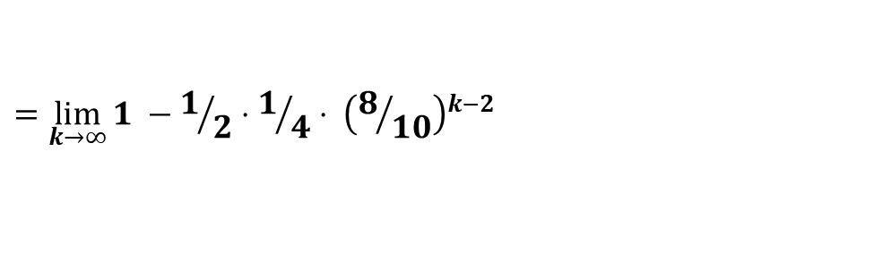
8.1e – Recurrence & Transience:
8.1 – Discrete State Space MCs
0.5
0.5
$$f_{11}=P\left(X^{(n)}=1 for some n≥1 | X^{\left(0\right)}=1 \right)$$
1
0.1
2
3
$$=1 − P\left(X^{(n)}≠1 for any n≥1 | X^{\left(0\right)}=1 \right)$$
0.75
$$=1 −0.1$$
0.9
$$=0.9<1$$
0.25
0.2
=> 1 is a transient state
4
$$S=\left\{1\right\}∪\left\{2, 3, 4\right\}$$
$$f_{22}=P\left(X^{(n)}=2 for some n≥1 | X^{\left(0\right)}=2 \right)$$
0.8
$$=\lim_{k→∞}{P\left(X^{(n)}=2 for some n=1, …,k | X^{\left(0\right)}=2 \right)}$$
$$=\lim_{k→∞}{1 −P\left(X^{(n)}≠2 for any n=1, …,k | X^{\left(0\right)}=2 \right)}$$
$$={\lim_{k→∞}{1 −P_{2,3}⋅P_{3,4}⋅ \left(P_{4,4}\right)}}^{k−2}$$
$$={\lim_{k→∞}{1 −1/2⋅1/4⋅ \left(8/{10}\right)}}^{k−2}$$
$$=1$$
10
=> 2 is a recurrent state => {2,3,4} is a recurrent class

Slide 11
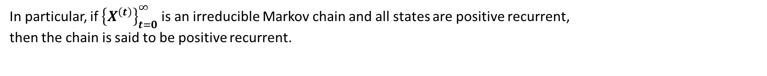
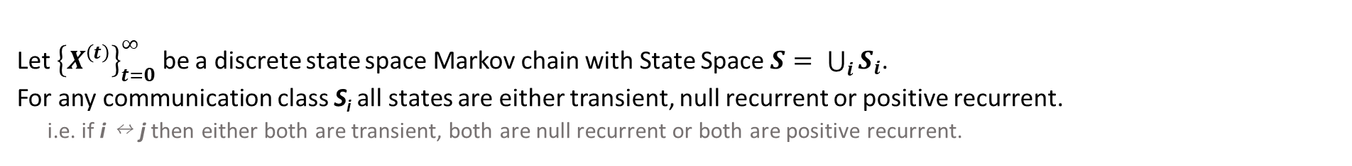
8.1f – Expected Return Time:
8.1 – Discrete State Space MCs
Define $τ_{ii}=min \left\{ n≥1 : X^{\left(n\right)}=i | X^{\left(0\right)}=i \right\}$
Hence the random variable $τ_{ii}$represents the time of first return to state i given that the chain started at state i.
A recurrent state i is said to be positive recurrent if the expected amount of time to return to i is finite
$E\left[ τ_{ii} \right]<∞$ => i is positive recurrent
A recurrent state i is said to be null recurrent if the expected amount of time to return to i is infinite
$E\left[ τ_{ii} \right]=∞$ => i is null recurrent
Theorem 3:
Let ${\left\{X^{\left(t\right)}\right\}}_{t=0}^{∞}$ be a discrete state space Markov chain with State Space $S= \bigcup_{i}{S_{i}}$.
For any communication class S_{i} all states are either transient, null recurrent or positive recurrent. i.e. if i ↔ j then either both are transient, both are null recurrent or both are positive recurrent.
“If two states communicate, they share the same nature”
In particular, if ${\left\{X^{\left(t\right)}\right\}}_{t=0}^{∞}$ is an irreducible Markov chain and all states are positive recurrent, then the chain is said to be positive recurrent.
11

Slide 12
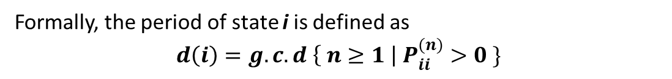
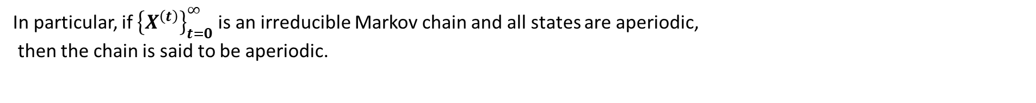
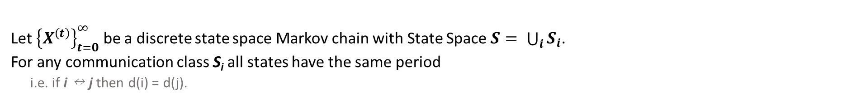
8.1g – Periodicity:
8.1 – Discrete State Space MCs
1
2
State i has period d = d(i) if any chain starting from i can only return to i in multiples of d steps.
3
Formally, the period of state i is defined as
$$d\left(i\right)=g.c.d \left\{ n≥1 \right| P_{ii}^{(n)}>0 \}$$
d(1) = d(2) = d(3) = 3
If d(i) > 1 we say that i is periodic If d(i) = 1 we say that i is aperiodic
Theorem 4:
Let ${\left\{X^{\left(t\right)}\right\}}_{t=0}^{∞}$ be a discrete state space Markov chain with State Space $S= \bigcup_{i}{S_{i}}$.
For any communication class S_{i} all states have the same period i.e. if i ↔ j then d(i) = d(j).
“If two states communicate, they share the same nature”
In particular, if ${\left\{X^{\left(t\right)}\right\}}_{t=0}^{∞}$ is an irreducible Markov chain and all states are aperiodic, then the chain is said to be aperiodic.
12

Slide 13
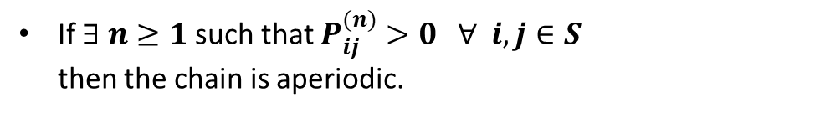

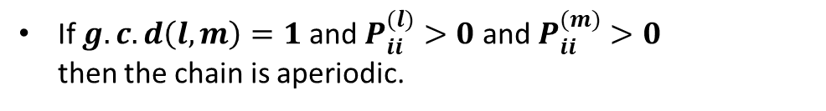
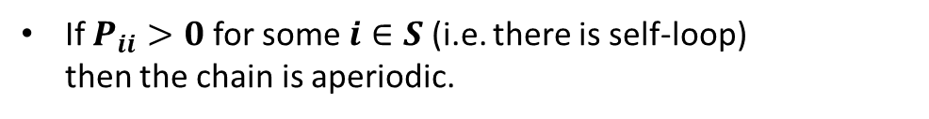
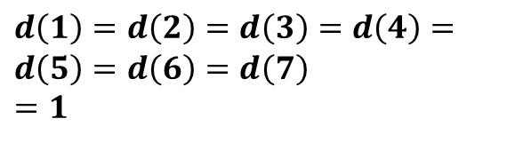
8.1g – Periodicity:
8.1 – Discrete State Space MCs
The following rules offer some simple tests to determine whether an irreducible Markov chain is aperiodic:
1
3
4
Let ${\left\{X^{\left(t\right)}\right\}}_{t=0}^{∞}$ be an irreducible Markov chain with a discrete state space
7
5
2
If $P_{ii}>0$ for some $i∈S$ (i.e. there is self-loop) then the chain is aperiodic.
6
$$S=\{1, 2, 3, 4, 5, 6, 7\}$$
If $g.c.d\left(l, m\right)=1$ and $P_{ii}^{(l)}>0$ and $P_{ii}^{(m)}>0$ then the chain is aperiodic.
$$d\left(1\right)=d\left(2\right)=d\left(3\right)=d\left(4\right)= \\ d\left(5\right)=d\left(6\right)=d\left(7\right)$$
$$=1$$
If $∃ n≥1$ such that $P_{ij}^{(n)}>0 ∀ i,j∈S$ then the chain is aperiodic.
13

Slide 14

8.1h – Probability Distributions:
8.1 – Discrete State Space MCs
In Section 8.1b we performed a random walk on this Markov chain starting at state 1.
# 1.1a - Defining state space and transition matrix.
library(markovchain)
statenames <- c("1", "2", "3", "4" , "5")
P <- matrix(c(0.00, 0.80, 0.00, 0.00, 0.20,
0.50, 0.00, 0.25, 0.00, 0.25,
0.00, 0.30, 0.30, 0.40, 0.00,
0.00, 0.00, 0.50, 0.00, 0.50,
0.50, 0.00, 0.25, 0.25, 0.00), nrow=5, byrow=TRUE,
dimnames = list(statenames, statenames))
0.5
1
0.8
0.2
0.5
5
2
0.25
0.25
0.3
0.25
0.25
# 1.1b - Specifying that the transition matrix defines a Markov chain
mc <- new("markovchain", transitionMatrix=P)
0.5
0.5
4
3
# 1.1c - Constructing a graph of the Markov chain
mc@transitionMatrix <- P
plot(mc)
0.4
0.3
There is no reason why we had to start at state 1. Indeed, we could have started the walk at any other state.
# 1.1d - Conducting a random walk on the Markov Chain stating a state 1 markovchainSequence(n=10, markovchain=mc, t0="1",
include=TRUE)
In general, the starting state of a Markov chain is a random variable defined by a probability distribution v.
[1] "1" "2" "1" "5" "1" "2" "3" "3" "4" "5" "3"
$$X^{(0)} \sim \underline{ v}$$
14

Slide 15
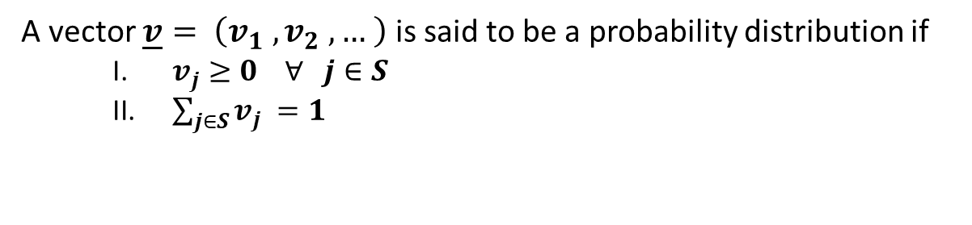
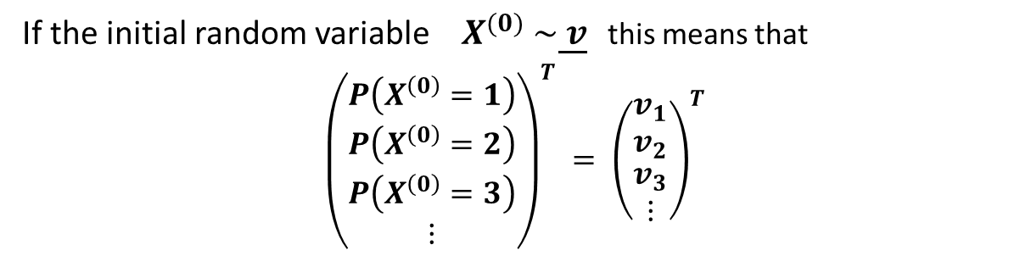
8.1h – Probability Distributions:
8.1 – Discrete State Space MCs
A vector $\underline{v}= \left(v_{1} , v_{2} , … \right)$ is said to be a probability distribution if
$v_{j}≥0 ∀ j∈S$
$\sum_{j∈S}{v_{j}} =1$
0.5
1
0.8
0.2
0.5
5
2
0.25
If the initial random variable $X^{(0)} \sim \underline{ v}$ this means that
$${\left(\begin{matrix}P\left(X^{\left(0\right)}=1\right) \\ P\left(X^{\left(0\right)}=2\right) \\ \begin{matrix}P\left(X^{\left(0\right)}=3\right) \\ ⋮\end{matrix}\end{matrix}\right)}^{T} = {\left(\begin{matrix}v_{1} \\ v_{2} \\ \begin{matrix}v_{3} \\ ⋮\end{matrix}\end{matrix}\right)}^{T}$$
0.25
0.3
0.25
0.25
0.5
0.5
4
3
0.4
0.3
For instance, in terms of the adjacent Markov chain, $X^{(0)}$ could be distributed according to any of the three probability distributions listed below:
$${\underline{ v}}_{a} = ( 1.0, 0.0, 0.0, 0.0, 0.0)$$
Start from state 1 with certainty
$${\underline{ v}}_{b} = ( 0.2, 0.2, 0.2, 0.2, 0.2)$$
Equal chance of starting from any state
$${\underline{ v}}_{c} = ( 0.1, 0.3, 0.1, 0.4, 0.1)$$
Most likely to start from state 4
15

Slide 16
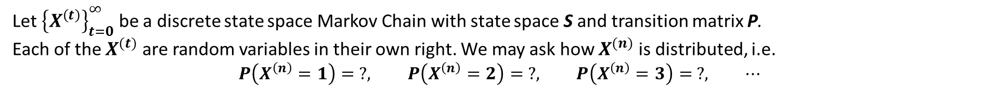
8.1h – Probability Distributions:
8.1 – Discrete State Space MCs
Let ${\left\{X^{\left(t\right)}\right\}}_{t=0}^{∞}$ be a discrete state space Markov Chain with state space S and transition matrix P.
Each of the $X^{(t)}$ are random variables in their own right. We may ask how $X^{(n)}$is distributed, i.e.
$$P\left(X^{\left(n\right)}=1\right)= ?, P\left(X^{\left(n\right)}=2\right)= ?, P\left(X^{\left(n\right)}=3\right)= ?, ⋯$$
The distribution of $X^{(n)}$ is completely determined by the transition matrix P and the distribution of $X^{(0)}$.
To see this, suppose that $X^{(0)} \sim \underline{v}$ and consider how $X^{(1)}$ is distributed.
By conditioning on i we have $∀ j∈S$
$$P\left(X^{\left(1\right)}=j\right) = \sum_{i∈S}{P\left(X^{(1)}=j | X^{\left(0\right)}=i\right) ⋅ P\left(X^{\left(0\right)}=i\right) = \sum_{i∈S}{P_{ij} v_{i} }}$$
We note that this last expression is simply the j^{th} element of the vector $\underline{v} P$ since
$\underline{v} P = \left(v_{1}, v_{2}, …\right) \left[\begin{matrix}P_{11} & P_{12} & ⋯ \\ P_{21} & P_{22} & ⋯ \\ ⋮ & ⋮ & ⋱\end{matrix}\right] = \left(\begin{matrix} \sum_{i∈S}{P_{i1} v_{i} , } & \sum_{i∈S}{P_{i2} v_{i} , } & ⋯\end{matrix} \right)$
We conclude that $X^{(1)} \sim \underline{v} P$
16

Slide 17


8.1h – Probability Distributions:
8.1 – Discrete State Space MCs
Let ${\left\{X^{\left(t\right)}\right\}}_{t=0}^{∞}$ be a discrete state space Markov Chain with state space S and transition matrix P.
Each of the $X^{(t)}$ are random variables in their own right. We may ask how $X^{(n)}$is distributed, i.e.
$$P\left(X^{\left(n\right)}=1\right)= ?, P\left(X^{\left(n\right)}=2\right)= ?, P\left(X^{\left(n\right)}=3\right)= ?, ⋯$$
The distribution of $X^{(n)}$ is completely determined by the transition matrix P and the distribution of $X^{(0)}$.
Likewise, suppose that $X^{(0)} \sim \underline{v}$ and consider how $X^{(n)}$ is distributed.
By conditioning on i we have $∀ j∈S$
$$P\left(X^{\left(n\right)}=j\right) = \sum_{i∈S}{P\left(X^{(n)}=j | X^{\left(0\right)}=i\right) ⋅ P\left(X^{\left(0\right)}=i\right) = \sum_{i∈S}{P_{ij}^{(n)} v_{i} }}$$
We note that this last expression is simply the j^{th} element of the vector $\underline{v} P^{n}$ since
$\underline{v} P^{n} = \left(v_{1}, v_{2}, …\right) \left[\begin{matrix}P_{11}^{(n)} & P_{12}^{(n)} & ⋯ \\ P_{21}^{(n)} & P_{22}^{(n)} & ⋯ \\ ⋮ & ⋮ & ⋱\end{matrix}\right] = \left(\begin{matrix} \sum_{i∈S}{P_{i1}^{(n)} v_{i} , } & \sum_{i∈S}{P_{i2}^{(n)} v_{i} , } & ⋯\end{matrix} \right)$
We conclude that $X^{(n)} \sim \underline{v} P^{n}$
If you want to know how $X^{(n)}$ is distributed take the initial probability vector $\underline{v}$ and multiply it on the right by $P^{n}$
17

Slide 18


8.1i – Stationary Distributions:
8.1 – Discrete State Space MCs
Let ${\left\{X^{\left(t\right)}\right\}}_{t=0}^{∞}$ be a discrete state space Markov Chain with state space S and transition matrix P.
A probability distribution $\underline{π}$ is said to be a stationary distribution for the chain if $\underline{π}=\underline{π} P$.
Stationary distributions have the following very useful property:
If $X^{(0)} \sim \underline{π}$
$$⇒ X^{(1)} \sim \underline{π} P = \underline{π}$$
$$X^{(2)} \sim \underline{π} P^{2} = \underline{π} P⋅P =\underline{π} P = \underline{π}$$
$$X^{(3)} \sim \underline{π} P^{3} = \underline{π} P⋅P^{2} =\underline{π} P^{2} =\underline{π} P⋅P =\underline{π} P = \underline{π}$$
$$⋮$$
$$X^{(n)} \sim \underline{π} P^{n} = \underline{π} P⋅P^{n−1} =\underline{π} P^{n−1} = ⋯ =\underline{π} P = \underline{π}$$
In other words, IF $X^{(0)} \sim \underline{π}$ then each random variable in the chain is also distributed according to $\underline{π}$.
This is why $\underline{π}$ is called a stationary distribution.
18

Slide 19
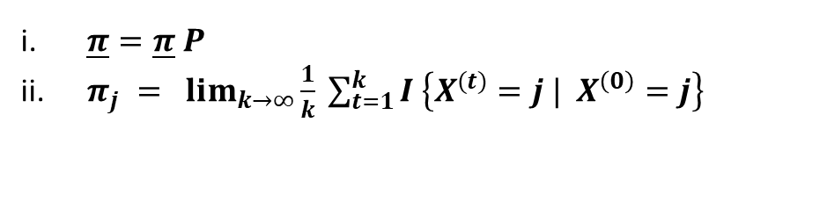
8.1i – Stationary Distributions:
8.1 – Discrete State Space MCs
Theorem 5:
Let ${\left\{X^{\left(t\right)}\right\}}_{t=0}^{∞}$ be an irreducible, positive recurrent Markov chain with discrete state space S and transition matrix P.
=> $∃$ a stationary distribution $\underline{π} =\left(\begin{matrix}π_{1}, & π_{2}, & ⋯\end{matrix} \right)$ such that:
$\underline{π}=\underline{π} P$
$π_{j} = \lim_{k→∞}{\frac{1}{k} \sum_{t=1}^{k}{I \left\{X^{(t)}=j | X^{\left(0\right)}=j\right\}}}$
Furthermore, if $\underline{π}′$ is a probability distribution such that $\underline{π}′=\underline{π} ′P$ then $\underline{π}′=\underline{π}$ such that in order to find the stationary distribution it suffices to find a solution to equation (i).
Notes:
Equation (ii) denotes that if a stationary distribution exists, then $π_{j}$ describes the long run proportion of time the chain spends in state j.
19

Slide 20
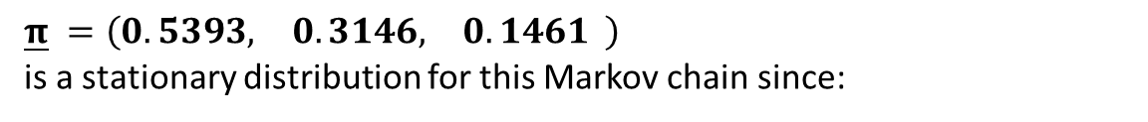
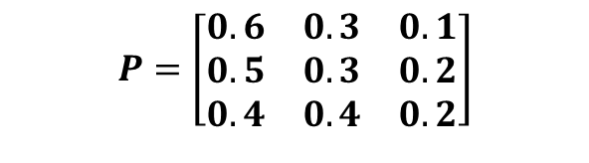
8.1i – Stationary Distributions:
8.1 – Discrete State Space MCs
0.3
$$P=\left[\begin{matrix}0.6 & 0.3 & 0.1 \\ 0.5 & 0.3 & 0.2 \\ 0.4 & 0.4 & 0.2\end{matrix}\right]$$
0.3
2
0.2
0.5
0.4
1
0.1
3
0.6
0.4
0.2
$\underline{π} =\left(\begin{matrix}0.5393, & 0.3146, & 0.1461\end{matrix} \right)$
is a stationary distribution for this Markov chain since:
$$\left(\begin{matrix}0.5393, & 0.3146, & 0.1461\end{matrix} \right)⋅\left[\begin{matrix}0.6 & 0.3 & 0.1 \\ 0.5 & 0.3 & 0.2 \\ 0.4 & 0.4 & 0.2\end{matrix}\right] =\left(\begin{matrix}0.5393, & 0.3146, & 0.1461\end{matrix} \right)$$
Viewed over a long enough timeline, the chain will spend approximately:
54% of the time in state 1
31% of the time in state 2
15% of the time in state 3
20

Slide 21
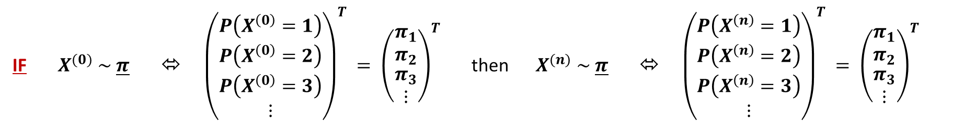

8.1j – Limiting Distributions:
8.1 – Discrete State Space MCs
Stationary distributions are useful because:
IF $X^{(0)} \sim \underline{π}$ ⬄ ${\left(\begin{matrix}P\left(X^{\left(0\right)}=1\right) \\ P\left(X^{\left(0\right)}=2\right) \\ \begin{matrix}P\left(X^{\left(0\right)}=3\right) \\ ⋮\end{matrix}\end{matrix}\right)}^{T} = {\left(\begin{matrix}π_{1} \\ π_{2} \\ \begin{matrix}π_{3} \\ ⋮\end{matrix}\end{matrix}\right)}^{T}$ then $X^{(n)} \sim \underline{π}$ ⬄ ${\left(\begin{matrix}P\left(X^{\left(n\right)}=1\right) \\ P\left(X^{\left(n\right)}=2\right) \\ \begin{matrix}P\left(X^{\left(n\right)}=3\right) \\ ⋮\end{matrix}\end{matrix}\right)}^{T} = {\left(\begin{matrix}π_{1} \\ π_{2} \\ \begin{matrix}π_{3} \\ ⋮\end{matrix}\end{matrix}\right)}^{T}$
However, we are going to need something more. We are going to need that…
$$P\left( X^{\left(n\right)}=j \right)→π_{j} as n→∞ ∀ j∈S$$
…irrespective of how $X^{(0)}$is distributed.
To achieve this, in addition to our chain being irreducible and positive recurrent, we are also going to have to ensure that it is aperiodic.
i.e. there is no number $d>1$ such that the chain can only return to each state in multiples of d steps
21

Slide 22
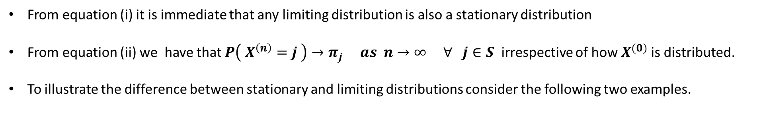
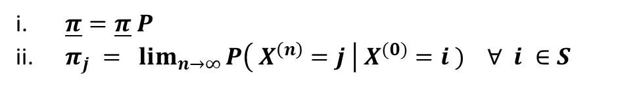
8.1j – Limiting Distributions:
8.1 – Discrete State Space MCs
Theorem 6:
Let ${\left\{X^{\left(t\right)}\right\}}_{t=0}^{∞}$ be an irreducible, ergodic (positive recurrent and aperiodic) Markov chain with discrete state space S and transition matrix P.
=> $∃$ a limiting distribution $\underline{π} =\left(\begin{matrix}π_{1}, & π_{2}, & ⋯\end{matrix} \right)$ such that:
$\underline{π}=\underline{π} P$
$π_{j} = \lim_{n→∞}{P\left( X^{\left(n\right)}=j \right| X^{(0)}=i ) ∀ i ∈S}$
Furthermore, if $\underline{π}′$ is a probability distribution such that $\underline{π}′=\underline{π} ′P$ then $\underline{π}′=\underline{π}$ such that in order to find the limiting distribution it suffices to find a solution to equation (i).
Notes:
From equation (i) it is immediate that any limiting distribution is also a stationary distribution
From equation (ii) we have that $P\left( X^{\left(n\right)}=j \right)→π_{j} as n→∞ ∀ j∈S$ irrespective of how $X^{(0)}$is distributed.
To illustrate the difference between stationary and limiting distributions consider the following two examples.
22

Slide 23
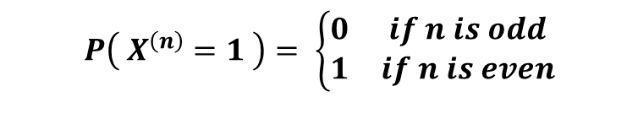
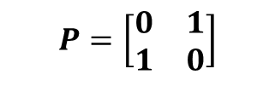
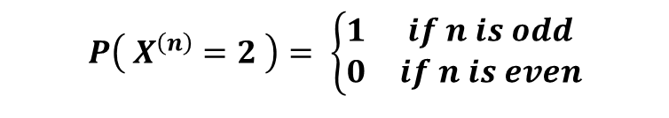
8.1j – Limiting Distributions:
8.1 – Discrete State Space MCs
EXAMPLE 1:
Consider the Markov chain defined by:
$$P=\left[\begin{matrix}0 & 1 \\ 1 & 0\end{matrix}\right]$$
1
2
The chain is irreducible and positive recurrent.
However, it is NOT aperiodic since $d\left(1\right)=d\left(2\right)=2$.
As per Theorem 5 the chain has stationary distribution $\underline{π} =\left( 0.5, 0.5 \right)$ since
$$\left( 0.5, 0.5 \right)⋅\left[\begin{matrix}0 & 1 \\ 1 & 0\end{matrix}\right] = \left( 0.5, 0.5 \right)$$
However, the chain does not have a limiting distribution* since if $X^{\left(0\right)}=1$ then…
$$P\left( X^{\left(n\right)}=1 \right)= \left\{\begin{matrix}0 & if n is odd \\ 1 & if n is even\end{matrix}\right.$$
$$P\left( X^{\left(n\right)}=2 \right)= \left\{\begin{matrix}1 & if n is odd \\ 0 & if n is even\end{matrix}\right.$$
… such that $\lim_{n→∞}{P\left( X^{\left(n\right)}=j \right)}$does not exist. A similar logic holds if $X^{\left(0\right)}=2.$
23
*Note that the fact that the chain has a stationary distribution which is not a limiting distribution does not contradict Theorem 6 because the chain is not aperiodic.

Slide 24
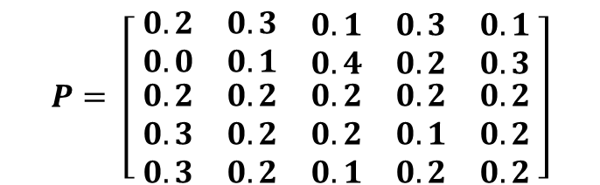
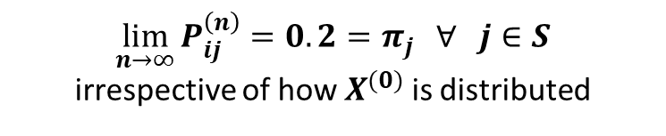
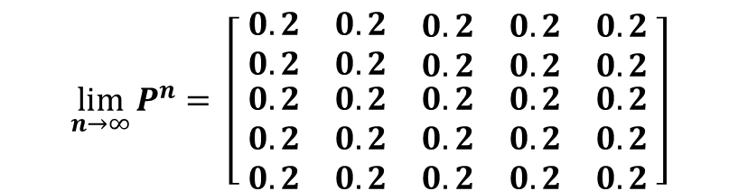
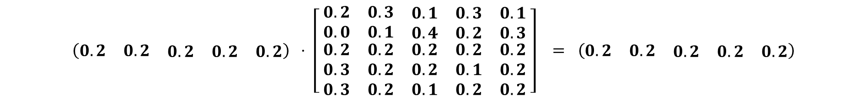
8.1j – Limiting Distributions:
8.1 – Discrete State Space MCs
EXAMPLE 2:
$$P= \left[\begin{matrix} 0.2 & 0.3 & \begin{matrix}0.1 & 0.3 & 0.1 \end{matrix} \\ 0.0 & 0.1 & \begin{matrix}0.4 & 0.2 & 0.3 \end{matrix} \\ \begin{matrix} 0.2 \\ 0.3 \\ 0.3\end{matrix} & \begin{matrix}0.2 \\ 0.2 \\ 0.2\end{matrix} & \begin{matrix}\begin{matrix}0.2 \\ 0.2 \\ 0.1\end{matrix} & \begin{matrix}0.2 \\ 0.1 \\ 0.2\end{matrix} & \begin{matrix}0.2 \\ 0.2 \\ 0.2 \end{matrix}\end{matrix}\end{matrix}\right]$$
Consider the Markov chain defined by:
The chain is irreducible and ergodic (positive recurrent and aperiodic)
As per Theorem 6 the chain has limiting distribution $\underline{π} = \left(\begin{matrix}0.2 & 0.2 & \begin{matrix}0.2 & 0.2 & 0.2\end{matrix}\end{matrix}\right)$ since
$$\left(\begin{matrix}0.2 & 0.2 & \begin{matrix}0.2 & 0.2 & 0.2\end{matrix}\end{matrix}\right) ⋅ \left[\begin{matrix} 0.2 & 0.3 & \begin{matrix}0.1 & 0.3 & 0.1 \end{matrix} \\ 0.0 & 0.1 & \begin{matrix}0.4 & 0.2 & 0.3 \end{matrix} \\ \begin{matrix} 0.2 \\ 0.3 \\ 0.3\end{matrix} & \begin{matrix}0.2 \\ 0.2 \\ 0.2\end{matrix} & \begin{matrix}\begin{matrix}0.2 \\ 0.2 \\ 0.1\end{matrix} & \begin{matrix}0.2 \\ 0.1 \\ 0.2\end{matrix} & \begin{matrix}0.2 \\ 0.2 \\ 0.2 \end{matrix}\end{matrix}\end{matrix}\right] = \left(\begin{matrix}0.2 & 0.2 & \begin{matrix}0.2 & 0.2 & 0.2\end{matrix}\end{matrix}\right)$$
$$\lim_{n→∞}{P^{n}}= \left[\begin{matrix} 0.2 & 0.2 & \begin{matrix}0.2 & 0.2 & 0.2 \end{matrix} \\ 0.2 & 0.2 & \begin{matrix}0.2 & 0.2 & 0.2 \end{matrix} \\ \begin{matrix} 0.2 \\ 0.2 \\ 0.2\end{matrix} & \begin{matrix}0.2 \\ 0.2 \\ 0.2\end{matrix} & \begin{matrix}\begin{matrix}0.2 \\ 0.2 \\ 0.2\end{matrix} & \begin{matrix}0.2 \\ 0.2 \\ 0.2\end{matrix} & \begin{matrix}0.2 \\ 0.2 \\ 0.2 \end{matrix}\end{matrix}\end{matrix}\right]$$
$$\lim_{n→∞}{P_{ij}^{\left(n\right)}=0.2=π_{j}} ∀ j∈S$$
irrespective of how $X^{(0)}$is distributed
Furthermore,
⬄
24

Slide 25
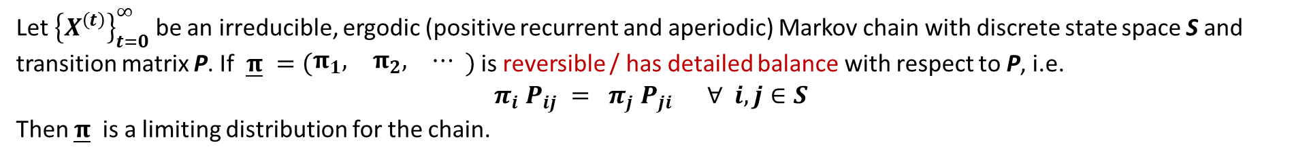
8.1k – Reversibility / Detailed Balance:
8.1 – Discrete State Space MCs
Theorem 7:
Let ${\left\{X^{\left(t\right)}\right\}}_{t=0}^{∞}$ be an irreducible, ergodic (positive recurrent and aperiodic) Markov chain with discrete state space S and transition matrix P. If $\underline{π} =\left(\begin{matrix}π_{1}, & π_{2}, & ⋯\end{matrix} \right)$ is reversible / has detailed balance with respect to P, i.e.
$$π_{i} P_{ij} = π_{j} P_{ji} ∀ i,j∈S$$
Then $\underline{π}$ is a limiting distribution for the chain.
Proof:
$$π_{i} P_{ij} = π_{j} P_{ji} ∀ i,j∈S$$
$$⇒ \sum_{i∈S}{π_{i} P_{ij}} = \sum_{i∈S}{π_{j} P_{ji}} = π_{j} \sum_{i∈S}{P_{ji}} = π_{j}$$
Since the left-hand side is just the j^{th} element of $\underline{π} P$ we have that $\underline{π} P=\underline{π}$.
From Theorem 6 this is enough to show that $\underline{π}$is the limiting distribution.
25

Slide 26
8.2 – Continuous State Space Markov Chains

Slide 27
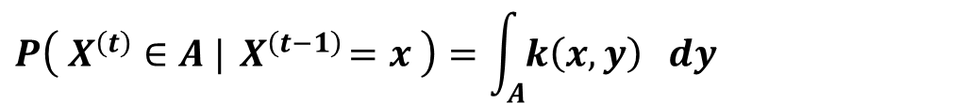
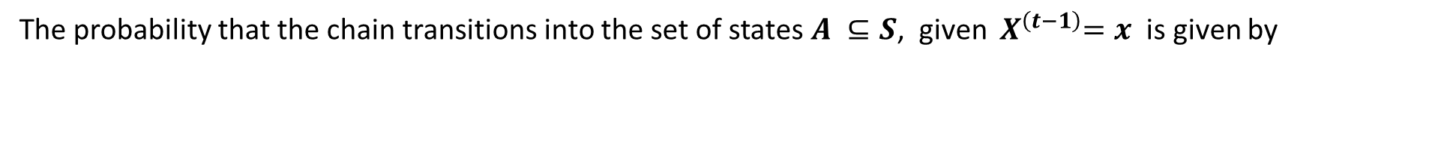
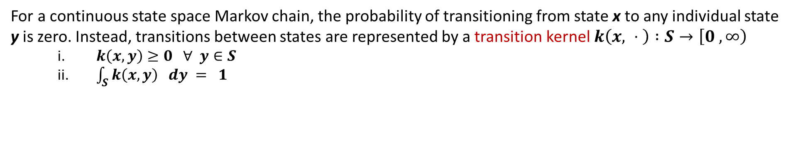
8.2a – Definition of a Markov Chain:
8.2 – Continuous State Space MCs
Suppose we have a sequence of random variables ${\left\{X^{\left(t\right)}\right\}}_{t=0}^{∞}$ indexed by discrete time intervals t = 0, 1, … , ∞ that take values in the continuous state space S. If the sequence has the property that $∀ A ⊆S$:
$$P\left( X^{\left(t\right)}∈A |{ X}^{\left(t−1\right)}=x_{t−1} , { X}^{\left(t−2\right)}=x_{t−2} , …,{ X}^{\left(0\right)}=x_{0 }\right) =P\left( X^{\left(t\right)}∈A |{ X}^{\left(t−1\right)}=x_{t−1} \right)$$
i.e. the state of the random variable at time t depends only on the state of the random variable at time t-1.
Then this sequence is known as a Markov Chain (MC).
For a continuous state space Markov chain, the probability of transitioning from state x to any individual state y is zero. Instead, transitions between states are represented by a transition kernel $k\left(x, ⋅ \right) :S→\left[0 , ∞\right)$
$k\left(x,y\right)≥0 ∀ y∈S$
$\int_{S}{k\left(x,y\right) dy} = 1$
The probability that the chain transitions into the set of states $A ⊆S$, given ${ X}^{\left(t−1\right)}=x$ is given by
$$P\left( X^{\left(t\right)}∈A |{ X}^{\left(t−1\right)}=x \right)=\int_{A}{k\left(x,y\right) dy}$$
27

Slide 28
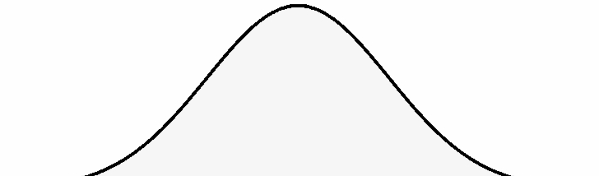
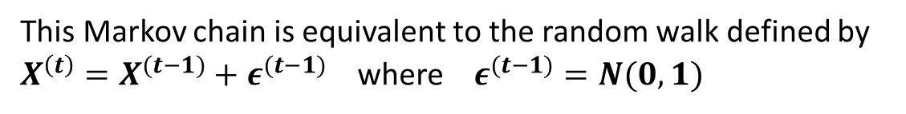



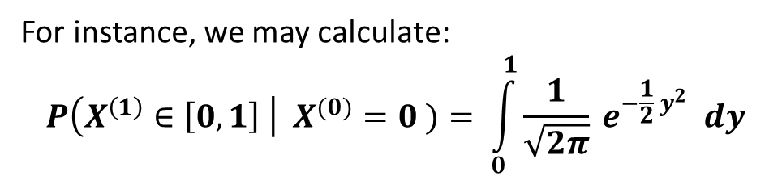
8.2a – Definition of a Markov Chain:
8.2 – Continuous State Space MCs
For example, consider the Markov chain ${\left\{X^{\left(t\right)}\right\}}_{t=0}^{∞}$ on $S=ℝ$ defined by $X^{(0)}=0$ and the transition kernel
$$k\left(x,y\right)= \frac{1}{\sqrt{2π}} e^{−\frac{1}{2} {\left(y −x\right)}^{2}}$$
This Markov chain is equivalent to the random walk defined by
$X^{\left(t\right)}=X^{(t−1)}+ε^{(t−1)}$ where $ε^{(t−1)}=N(0,1)$
$X^{(1)}$
t=1
t=2
For instance, we may calculate:
$$P\left(X^{\left(1\right)}∈\left[0,1\right] \right| X^{(0)}=0 )= \int_{0}^{1}{\frac{1}{\sqrt{2π}} e^{−\frac{1}{2} y^{2}} dy}$$
$X^{(0)}$
$X^{(2)}$
$= P\left( Z≤1\right) − P\left( Z≤0\right) = 0.3413$
28

Slide 29

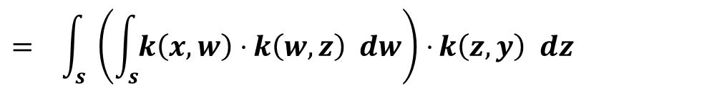
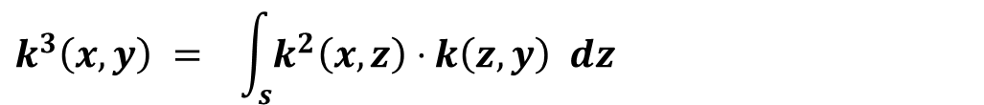
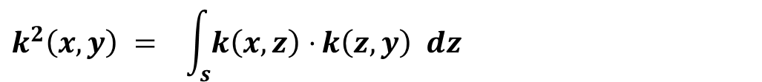
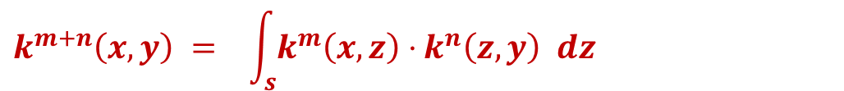
8.2b – n-step Transition Probabilities
8.2 – Continuous State Space MCs
Let ${\left\{X^{\left(t\right)}\right\}}_{t=0}^{∞}$ be a Markov chain with continuous state space S and a transition kernel $k\left(x, ⋅ \right) :S→\left[0 , ∞\right).$
The continuous versions of the Kolmogorov-Chapman equations are:
$$k^{m+n}\left(x,y\right) = \int_{s}{k^{m}\left(x,z\right)⋅}k^{n}\left(z,y\right) dz$$
Integrate over all possible intermediary states at $t=m$
In particular, we have:
$$k^{2}\left(x,y\right) = \int_{s}{k\left(x,z\right)⋅}k\left(z,y\right) dz$$
y
$$k^{3}\left(x,y\right) = \int_{s}{k^{2}\left(x,z\right)⋅}k\left(z,y\right) dz$$
$$= \int_{s}{ \left(\int_{s}{k\left(x,w\right)⋅}k\left(w,z\right) dw\right)⋅}k\left(z,y\right) dz$$
x
m
m+n
29

Slide 30
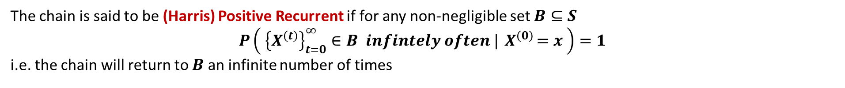
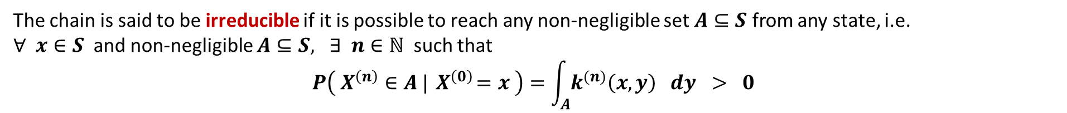
8.2c – Classification of Markov Chains:
8.2 – Continuous State Space MCs
Let ${\left\{X^{\left(t\right)}\right\}}_{t=0}^{∞}$ be a Markov chain with continuous state space S and a transition kernel $k\left(x, ⋅ \right) :S→\left[0 , ∞\right)$
The chain is said to be irreducible if it is possible to reach any non-negligible set $A⊆S$ from any state, i.e.
$∀ x∈S$ and non-negligible $A⊆S, ∃ n∈ℕ$ such that
$$P\left( X^{\left(n\right)}∈A |{ X}^{\left(0\right)}=x \right)=\int_{A}{k^{(n)}\left(x,y\right) dy} > 0$$
The chain is said to be (Harris) Positive Recurrent if for any non-negligible set $B⊆S$
$$P\left( {\left\{X^{\left(t\right)}\right\}}_{t=0}^{∞}∈B infintely often |{ X}^{\left(0\right)}=x \right)=1$$
i.e. the chain will return to $B$ an infinite number of times
The chain is said to be aperiodic if for any non-negligible set $C⊆S$ the g.c.d of all possible return times to $C$ is 1,
i.e. $∄$ any $d≥2$ such that the chain can only return to $C$in multiples of $d$ steps.
A sufficient condition for aperiodicity is that $∀ x∈S, k\left(x, ⋅ \right)>0$ in a neighbourhood of $x$. This means that the chain can remain in a neighbourhood of $x$an arbitrary number of steps before visiting other sets.
This is the analogue of self-transitions within discrete state space Markov chains.
30

Slide 31
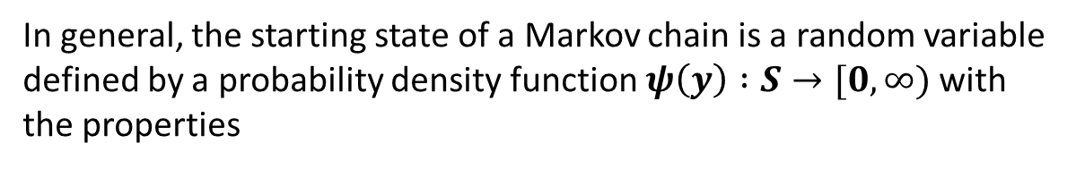

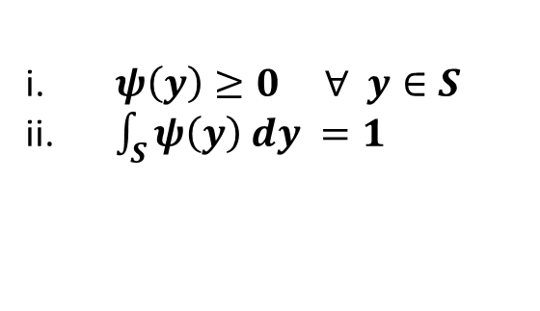
8.2d – Probability Distributions:
8.2 – Continuous State Space MCs
In Section 8.2a we defined the Markov chain ${\left\{X^{\left(t\right)}\right\}}_{t=0}^{∞}$ by the transition kernel
$k\left(x,y\right)= \frac{1}{\sqrt{2π}} e^{−\frac{1}{2} {\left(y −x\right)}^{2}}$ and initial state $X^{(0)}=0$
However, there is no reason that the chain should have to start at 0. Indeed, we could have started the chain at any other point on the real line.
$X^{(1)}$
$X^{(0)}$
t=1
t=2
In general, the starting state of a Markov chain is a random variable defined by a probability density function $ψ\left(y\right) :S→[0, ∞)$ with the properties
$X^{(2)}$
$ψ\left(y\right)≥0 ∀ y∈S$
$\int_{S}{ψ\left(y\right) dy =1}$
We write $X^{(0)} \sim ψ(y)$
31

Slide 32


8.2d – Probability Distributions:
8.2 – Continuous State Space MCs
Let ${\left\{X^{\left(t\right)}\right\}}_{t=0}^{∞}$ be a Markov chain with continuous state space S and a transition kernel $k\left(x, ⋅ \right) :S→\left[0 , ∞\right)$
Each of the $X^{(t)}$ are random variables in their own right.
We may ask how $X^{(n)}$is distributed.
Again, the distribution of $X^{(n)}$ is completely determined by the transition kernel $k\left(x, ⋅ \right)$ and the distribution of $X^{(0)}$.
If $X^{(0)} \sim ψ(y)$ then
$$X^{(1)} \sim ψ_{1}\left(y\right)≡\int_{s}{k\left(x,y\right) ψ\left(x\right) dx}$$
$$X^{(2)} \sim ψ_{2}\left(y\right)≡\int_{s}{k^{(2)}\left(x,y\right)ψ\left(x\right) dx}$$
$$⋮$$
$$X^{(n)} \sim ψ_{n}\left(y\right)≡\int_{s}{k^{(n)}\left(x,y\right)ψ\left(x\right) dx}$$
32

Slide 33




8.2e – Stationary Distributions:
8.2 – Continuous State Space MCs
Let ${\left\{X^{\left(t\right)}\right\}}_{t=0}^{∞}$ be a Markov chain with continuous state space S and a transition kernel $k\left(x, ⋅ \right) :S→\left[0 , ∞\right)$
A probability density function $π\left(y\right) :S→\left[0, ∞\right)$ is said to be a stationary distribution for the chain if
$$π\left(y\right)= \int_{S}{k\left(x,y\right) π(x)} dx$$
Again, stationary distributions have the following very useful property:
If $X^{(0)} \sim π(y)$ then
$$X^{(1)} \sim \int_{s}{k\left(x,y\right) π\left(x\right) dx} = π(y)$$
$$X^{(2)} \sim \int_{s}{k^{(2)}\left(x,y\right) π(x) dx} = \int_{S}{ \left(\int_{S}{k\left(x,z\right)k\left(z,y\right) .dz}\right)} π\left(x\right) dx$$
$$= \int_{S}{ \left(\int_{S}{k\left(x,z\right) π\left(x\right) dx}\right)k\left(z,y\right)} dz =\int_{S}{ π\left(z\right) k\left(z,y\right)} dz = π(y)$$
$$⋮$$
$$X^{(n)} \sim \int_{s}{k^{(n)}\left(x,y\right) π\left(x\right) dx} = … = π(y)$$
If $X^{(0)} \sim π\left(y\right)$ then each random variable in the chain is also distributed according to $π\left(y\right).$
This is why $π\left(y\right)$ is called a stationary distribution.
33

Slide 34

8.2f – Limiting Distributions:
8.2 – Continuous State Space MCs
Stationary distributions are useful because IF $X^{(0)} \sim π(y)$ then $X^{(n)} \sim π(y)$
However, we are going to need that…
$$k^{\left(n\right)}\left(x,y\right)→π\left(y\right) as n→∞$$
… irrespective of how $X^{(0)}$ is distributed.
Theorem 8:
Let ${\left\{X^{\left(t\right)}\right\}}_{t=0}^{∞}$ be a Markov chain with continuous state space S and a transition kernel $k\left(x, ⋅ \right) :S→\left[0 , ∞\right)$
If the chain is irreducible and ergodic (Harris positive recurrent and aperiodic)
$∃$ a unique limiting distribution $π\left(y\right) :S→\left[0, ∞\right)$such that:
$π\left(y\right)= \int_{S}{k\left(x,y\right) π(x)} dx$
$\lim_{n→∞}{k^{\left(n\right)}\left(x,y\right)=π(y)}$
i.e. the n^{th}-step transition kernel $k^{\left(n\right)}\left(x,y\right)$ converges to $π(y)$ in the total variation norm such that
$∀ ε>0 ∃ N∈ℕ$ such that if $n≥N$ then ${\left\|k^{\left(n\right)}\left(x,y\right)−π\left(y\right)\right\|}_{TV}≡ \sup_{S}{|k^{\left(n\right)}\left(x,y\right)−π(y)} | <ε$
Furthermore, if $π^{′}\left(y\right)$ is a probability density function satisfying equation (i) then $π^{′}\left(y\right)$ = $π\left(y\right)$ such that in order to find the limiting distribution it suffices to find a solution to equation (i).
34

Slide 35

8.2g – Reversibility / Detailed Balance:
8.2 – Continuous State Space MCs
Theorem 9:
Let ${\left\{X^{\left(t\right)}\right\}}_{t=0}^{∞}$ be an irreducible and ergodic (Harris positive recurrent and aperiodic) Markov chain with continuous state space S and a transition kernel $k\left(x, ⋅ \right) :S→\left[0 , ∞\right)$. If $π$ is reversible / exhibits detailed balance with respect to k, i.e.
$$π\left(x\right) k\left(x,y\right) = π\left(y\right) k\left(y,x\right) ∀ x,y∈S$$
Then $π$ is a limiting distribution for the chain.
Proof:
$$π\left(x\right) k\left(x,y\right) = π\left(y\right) k\left(y,x\right) ∀ x,y∈S$$
$$⇒ \int_{S}{π\left(x\right) k\left(x,y\right) dx }= \int_{S}{π\left(y\right) k\left(y,x\right)} dx = π\left(y\right) \int_{S}{k\left(y,x\right) dx} = π(y)$$
By Theorem 8 this is enough to show that $π$ is the limiting distribution.
35

Slide 36
8.2g – Reversibility / Detailed Balance:
8.2 – Continuous State Space MCs
Theorem 9:
Let ${\left\{X^{\left(t\right)}\right\}}_{t=0}^{∞}$ be an irreducible and ergodic (Harris positive recurrent and aperiodic) Markov chain with continuous state space S and a transition kernel $k\left(x, ⋅ \right) :S→\left[0 , ∞\right)$. If $π$ is reversible / exhibits detailed balance with respect to k, i.e.
$$π\left(x\right) k\left(x,y\right) = π\left(y\right) k\left(y,x\right) ∀ x,y∈S$$
Then $π$ is a limiting distribution for the chain.
Proof:
$$π\left(x\right) k\left(x,y\right) = π\left(y\right) k\left(y,x\right) ∀ x,y∈S$$
$$⇒ \int_{S}{π\left(x\right) k\left(x,y\right) dx }= \int_{S}{π\left(y\right) k\left(y,x\right)} dx = π\left(y\right) \int_{S}{k\left(y,x\right) dx} = π(y)$$
By Theorem 8 this is enough to show that $π$ is the limiting distribution.
If we have an irreducible and ergodic, continuous state space Markov chain with transition kernel $k(x,.)$ and if $π(y)$ exhibits detailed balance with respect to k
then $k^{n}\left(x,y\right)→π(y)$ as $n→∞$.
36

